Slide 1
CSE 4165: Web Programming
WELCOME!

Slide 2
Regarding the course
Mark Distribution:
Attendance: 10
Project with Viva: 30
Prototype Presentation with viva (Week 3): 10
Interim Demonstration (Week 8, 50% of Project (Front End) + Viva): 10
Final Demonstration (Week 12, 100% of Project + Viva): 10
In order to effectively utilize time the viva questions may be given in the form of a quiz (same questions written)
Midterm Exam: 30 (University-declared Midterm Week)
Final Exam: 30 (University-declared Final Week)

Slide 3
Regarding the course
Course Plan:
Week | Class Topic | Tasks
1 | HTML | Lecture Announcement of Group creation, each group will be a team of 4 members.
2 | HTML | Lecture A group form will be provided to take the group name, each member's name and student ID. Projects will be assigned randomly, different groups will have to do different projects assigned by course teachers. Student cannot propose their own project.
3 | HTML | Lecture Prototype Presentation. 10 Marks. Students will present their prototype of the project assigned to them using Figma
4 | CSS | Lecture
5 | CSS | Lecture
6 | JS | Lecture
Mid Exam following official UIU Calendar (Syllabus: HTML, CSS)

Slide 4
Regarding the course
Course Plan:
Week | Class Topic | Tasks
7 | JS | Lecture
8 | PHP | Lecture Interim Demonstration - 10 Marks Students will demonstrate their project directly It is expected students will complete the front end of the project
9 | PHP | Lecture
10 | PHP | Lecture
11 | MySQL | Lecture
12 | MySQL | Final Demonstration -10 Marks Students will demonstrate their project directly. It is expected students completed at least 100% of the project.
Final Exam following official UIU Calendar (Syllabus: JS, PHP, MYSQL)

Slide 5
Conduct of the class

Slide 6
Conduct of the class
How to properly prepare for this course?
Class lectures and class notes
You must bring a notebook and a pen
Take notes diligently
Structuring your own notes at home
If required you may keep another separate note book for this
Revising and recalling
Try to complete the topics that are taught by the end of the week
Coding
Practice and code the contents taught in class

Slide 7
Conduct of the class
Regarding class conduct
DO NOT use your phones during the class time
If you want to take a picture of the board – inform first
Sometimes I myself may tell you to take a picture of the board
Be mindful in the class
Follow the class lecture even if you feel tired at times
Quick tip – coffee before class
Do not be engaged in other tasks whilst the class is ongoing
Be present timely
If absent in a class, collect the class notes from your classmates (the notes must be in your Notebook)

Slide 8
Counselling Hours and Communication

Slide 9
Counselling Hours and Communication
Regarding the counselling hours
The schedule will be available in the UCAM
No appointment is needed but
It would be better if you inform me earlier for convenience
Come to the counselling hours being “prepared”
Must have the complete class note (if missed, collect from your classmates into your own notebook)
Must have explored the topic before coming

Slide 10
Counselling Hours and Communication
How will we be communicating?
You will message me via email – shadman@cse.uiu.ac.bd
Please write the mails yourselves without using AI
Use appropriate subjects while sending the mail
Use you university mails
I will send messages via
The elms
The mail
You must check your mails regularly and keep the mail notification on
Also you must check the elms regularly

Slide 11
Counselling Hours and Communication
You must communicate with your classmates too!
Create a WhatsApp group
DO NOT add me!
Form study groups

Slide 12


A Bit About The Course Teacher
University Profile
Google Scholar Profile

Slide 13
Start Making Friends
MUST ENSURE IT BY TODAY!

Slide 14
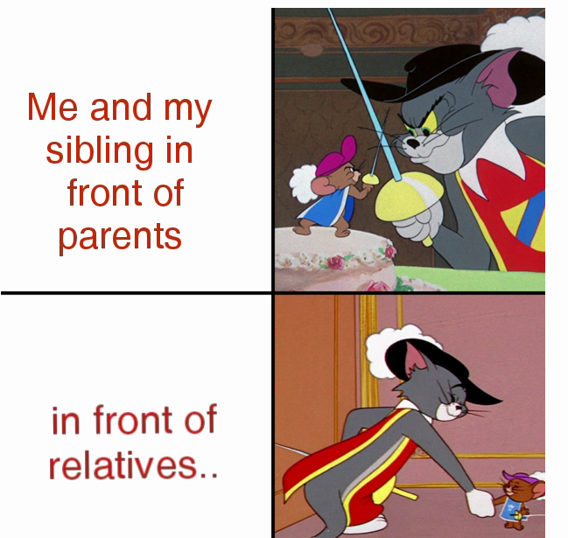
Start Making Friends
Make your groups very carefully.
Internal conflicts of the group will NOT be handled by the course teacher.
Viva (or quiz) will ensure that your efforts are rewarded
During group work
During presentation
in front of faculty

Slide 15
HTML
Hypertext Markup Language

Slide 16
What is HTML?
Hyper Text Mark Up Language
It is a coding language
Not a programming language
Rather a mark up language
Hypertext - Text that can connect you to other pages
Markup - annotating text (tags) to tell the computer how it should look or behave.

Slide 17
A HTML file
A special type of file with html tags
Ends with the extension .html
An editor is needed to edit
A browser is needed to render it
Let’s make a small html file now!
<!DOCTYPE html>
<html>
<head>
<meta charset = “UTF8”>
<title>My First Page</title>
</head>
<body>
<h1>Hello, World!</h1>
<p>This is my first HTML page.</p>
</body>
</html>
Self Closing Tag
Paired Tag
<!DOCTYPE html> → tells the browser it’s an HTML5 document
<html> → wraps the whole page
<head> → holds the page title and meta data (not shown on the page itself)
<body> → holds the visible content
<h1> → heading
<p> → paragraph

Slide 18
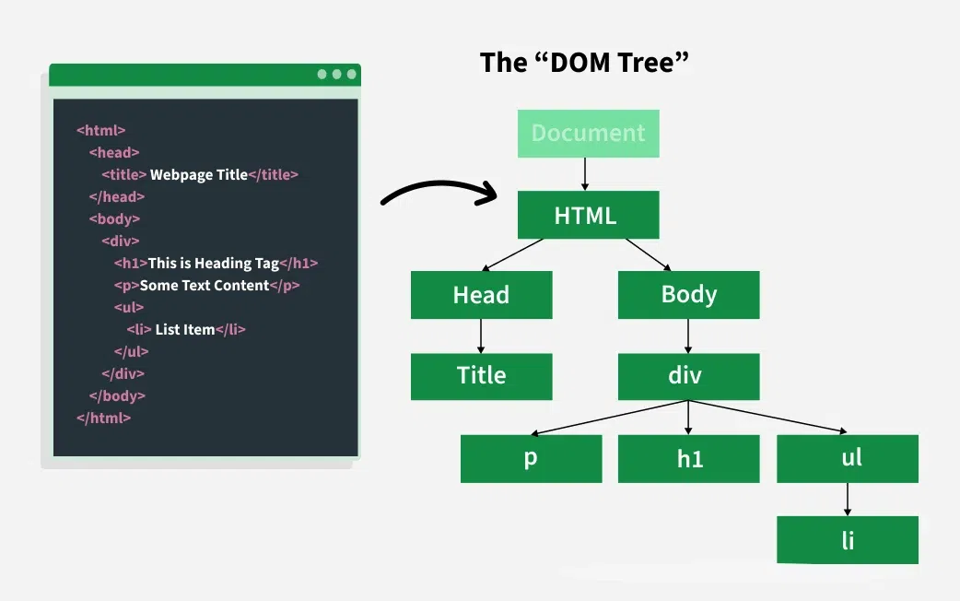
HTML follows the Document Object Model (DOM)
The Document Object Model (DOM) is a tree-like structure that the browser creates from the HTML code written by developers to represent the structure of a webpage.
Because of this tree like structure
we follow whilst writing code,
the browser can easily understand
which element is to be placed
within which element.

Slide 19
A brief history of HTML
Throughout history, since 1990, HTML has evolved rapidly.
Currently we are using the 5th version

Slide 20
A brief history of HTML
Mosaic Browser (1993) –
First graphical browser (by Marc Andreessen).
Could show text and images together.
Made the web popular.
XHTML 1.0 (2000) –
Stricter version of HTML based on XML.
Required well-formed code.
Too strict for many developers.
HTML 3.2 (1997) –
Managed by W3C.
Included JavaScript, and CSS support.
1990
1993
1995
1997
1999
2000
2014
HTML5 (2014) –
Modern version for multimedia and apps.
Added new tags like <header>, <section>, <video>, <audio>.
Supports APIs, offline apps, and graphics.
Still the current standard
HTML (1990) –
Created by Tim Berners-Lee at CERN.
Used to link research papers.
Text only, no colors or images.
Worked on any computer system.
HTML 2.0 (1995) –
First official standard by IETF.
Added forms, tables, and better structure.
HTML 4.01 (1999) –
Improved structure and accessibility.
Encouraged separating content (HTML) and style (CSS).

Slide 21
How a page request works?
- https://www.uiu.ac.bd
Part | Example | Details
Protocol / Scheme | https://, http://, ftp:// | This tells the browser how to access the resource.
Subdomain | www. , mail. , news. | Prefix – purpose of the site
Domain name | uiu, google, mist, | This is the main website name (here, United International University).
Top-Level Domain (TLD) | .ac.bd , .gov.bd | This shows the type and country: ac → academic or university, bd → Bangladesh (country code).
Document | index.html, a pdf file | Some times automatically selected

Slide 22
How a page request works?
The browser looks up the domain in the DNS (Domain Name System).
DNS returns the ip address
The browser sends the HTTP request to the server located at that address
The server finds the requested file(s) and sends it back
The browser takes this response and renders it graphically (can make more requests whilst rendering)
- Can we see all the files that are sent to us? (YES!)

Slide 23
The Live Server

Slide 24

The Live Server
Download and install this extension in vscode.
It will make the coding process more efficient

Slide 25
HTML5 Tags and Syntax

Slide 26
Different HTML Tags
There are many!
But we will cover all the important ones
We can classify the tags as
Block tags
Inline tags
We can also classify the tags as
Self closing tags
Paired tags

Slide 27
Block Tags and Inline Tags
Block tags always start on a new line and take up the full width available.
<div> — generic container
<p> — paragraph
<h1> to <h6> — headings
<header> — page or section header
<footer> — page or section footer
<section> — defines a section
<article> — self-contained content
<nav> — navigation links
<main> — main content area
<aside> — sidebar content
<ul>, <ol> — lists
<li> — list item
<table> — table
<form> — form container

Slide 28
Block Tags and Inline Tags
Inline tags do not start on a new line — they appear within text flow.
<span> — generic inline container
<a> — hyperlink
<img> — image
<strong> — bold (important text)
<em> — italic (emphasized text)
<b> — bold text
<i> — italic text
<u> — underlined text
<small> — smaller text
<br> — line break
<label> — form label
<input> — input field

Slide 29
Self closing tags and paired tags
Paired tags – also called container tags
These have both an opening and a closing tag.
Used when the element has content inside it.
<p>This is a paragraph.</p>
<h1>Heading</h1>
Self-Closing (or Void) Tags
These don’t have a closing tag because they don’t contain content.
They just perform an action or display something on their own.
<img src="photo.jpg" alt="My Photo">
<br>

Slide 30
Semantic Tags and Non Semantic Tags
Examples of non-semantic elements/tags:
<div> and <span>
Tells nothing about its content.
Examples of semantic elements/tags:
<img>, <table>, and <article>
Clearly defines its content.

Slide 31
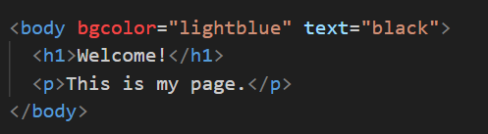
Let’s Learn About Some Useful Tags
<body>
Contains everything visible on the webpage
Comes after <head>
Attributes:
bgcolor → background color
text → text color
background → image as background

Slide 32
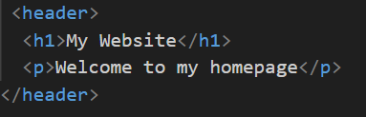
Let’s Learn About Some Useful Tags
<header>
Appears at the top of a page or section
Usually contains logo, heading, or navigation
Type: Block element

Slide 33
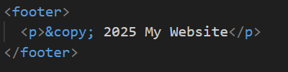
Let’s Learn About Some Useful Tags
<footer>
Appears at the bottom of a page or section
Used for copyright, contact, or closing notes

Slide 34

Let’s Learn About Some Useful Tags
<div>
Used to group content or make sections
Type: Block-level container
Attributes:
id → unique name
width, height → size
bgcolor → background color (in older HTML)

Slide 35
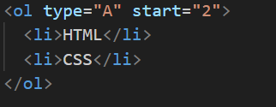
Let’s Learn About Some Useful Tags
<ol> (Ordered List)
Creates a numbered list
Attributes:
type → "1", "A", "a", "I", "i“
start → starting number

Slide 36
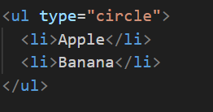
Let’s Learn About Some Useful Tags
<ul> (Unordered List)
Creates a bulleted list
Attribute:
type → "disc", "circle", "square"

Slide 37
Let’s Learn About Some Useful Tags
<img>
Shows an image
Self-closing tag
Attributes:
src → image path
alt → alternate text
width, height → size
border → border size

Slide 38
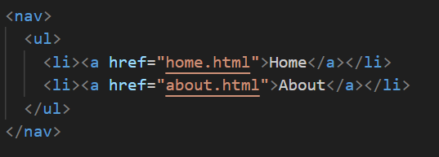
Let’s Learn About Some Useful Tags
<nav>
Holds navigation links (menus)
Usually used with list items

Slide 39
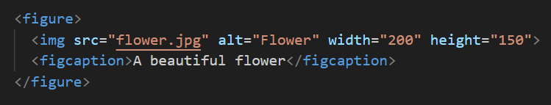
Let’s Learn About Some Useful Tags
<figure> and <figcaption>
Used to display image with a caption
<figure> is a container

Slide 40
Let’s Learn About Some Useful Tags
<a> — Hyperlinks
Creates clickable links
Absolute, relative, embedded
Images as links
Attributes:
href → link or reference
target="_blank" → opens in new tab (by default it is _self)
title → shows text when hovered

Slide 41
Special Symbols
Code | Shows | Meaning
&lt; | < | Less than
&gt; | > | Greater than
&amp; | & | Ampersand
&copy; | © | Copyright
&nbsp; |  | Space

Slide 42
The Table Tag and the Style Attribute
Tables can be constructed using the following tags
<table> <th> <td> <tr>
Note that all tags do not support color by default. However,
we can use the style attribute (inline CSS)

Slide 43
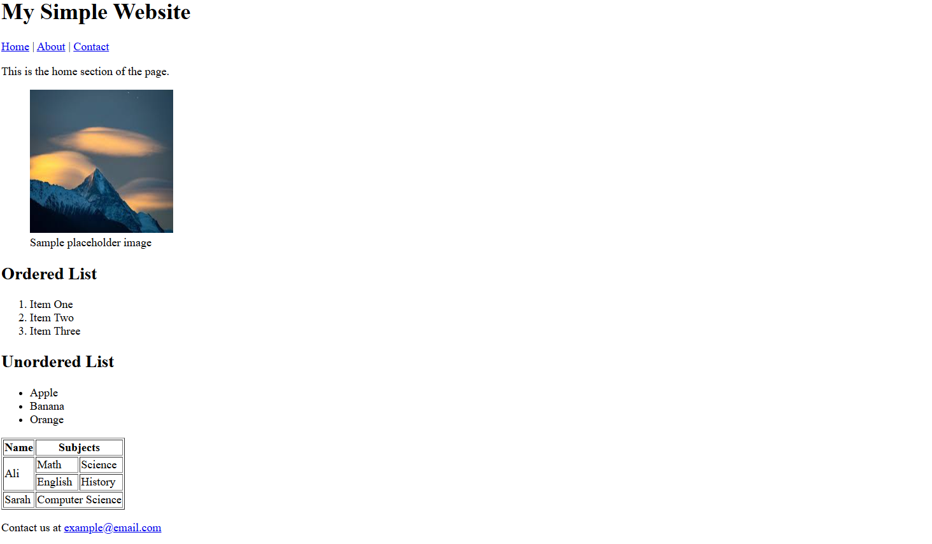
https://url-shortener.me/EV0X

Slide 44
Thank You

